Slide 1

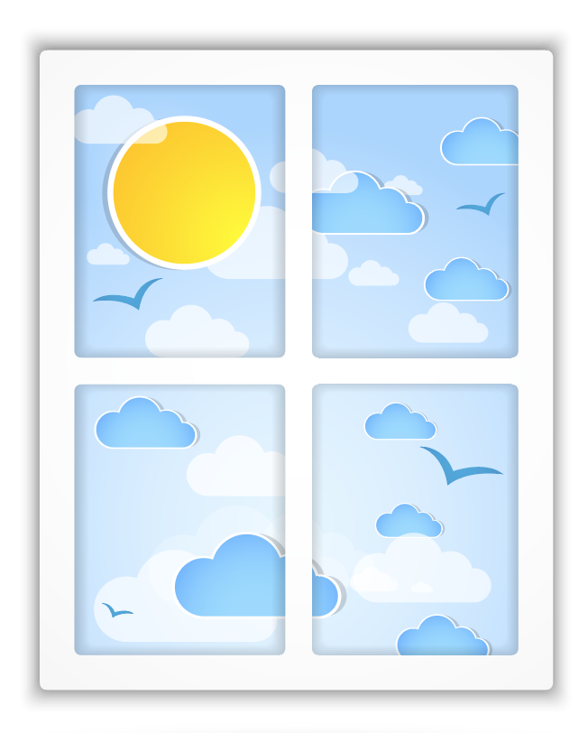

Tha i grianach an-diugh.
Am faod mi a dhol a-mach?
Notes:
It is sunny today. May I go out?

Slide 2
Faodaidh.
Cuir ort do speuclairean dubha agus do cheap grèine.
Notes:
Yes (you may). Put on your sunglasses and your sun cap.

Slide 3

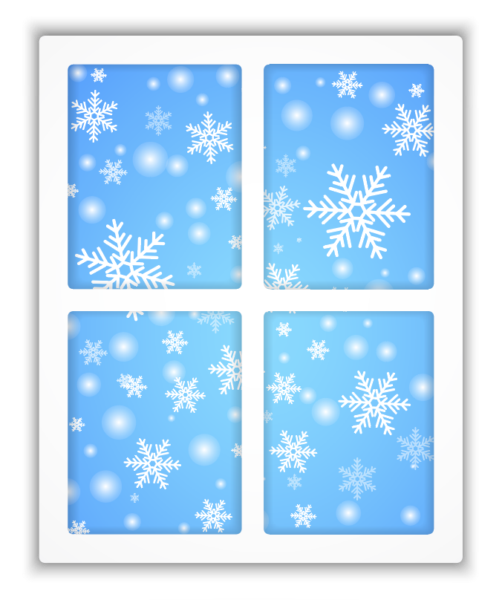
Tha i fuar
an-diugh. Am faod mi a dhol a-mach?
Notes:
It is cold today. May I go out?

Slide 4
Faodaidh.
Cuir ort do sheacaid agus do bhriogais bhlàth.
Notes:
Yes (you may). Put on your jacket and your warm trousers.

Slide 5
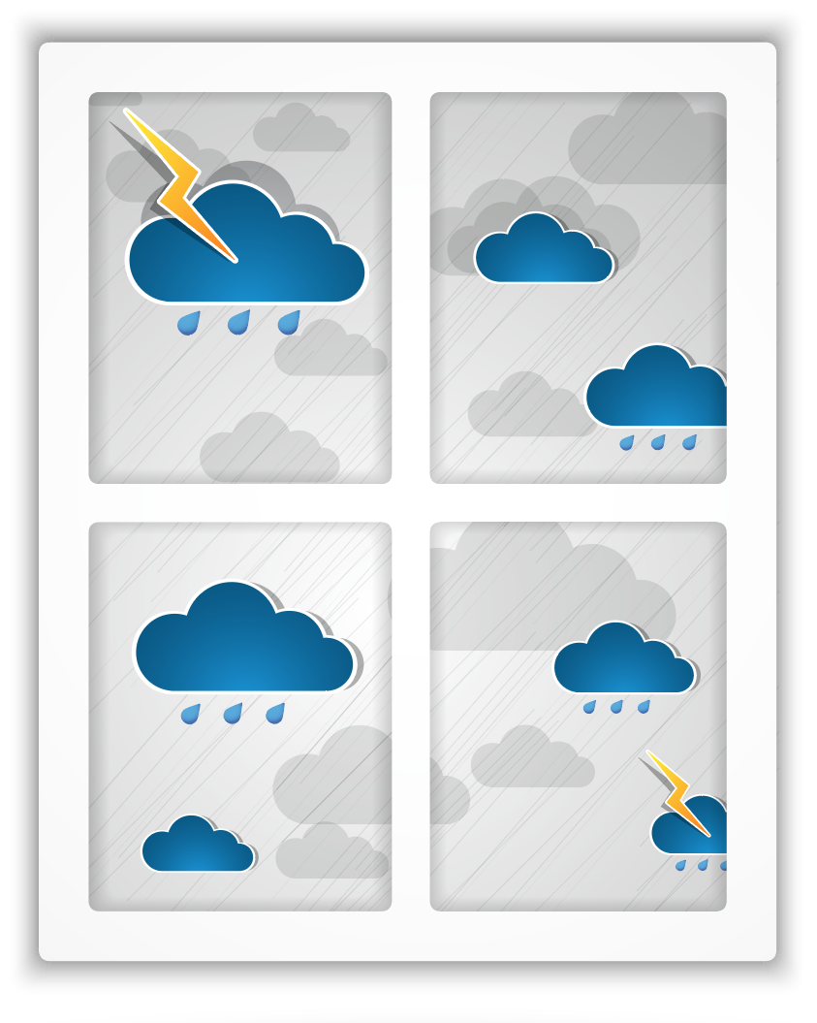
Tha i fliuch an-diugh. Am faod mi a dhol a-mach?
Notes:
It is wet today. May I go out?

Slide 6
Faodaidh. Cuir ort do bhòtannan agus do chòta- froise.
Notes:
Yes (you may). Put on your boots and your rain coat.

Slide 7
Tha sneachda ann an-diugh. Am faod mi a dhol a-mach?
Notes:
There’s snow today. May I go out?

Slide 8
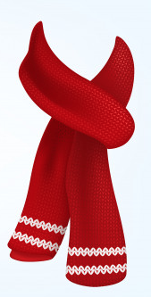
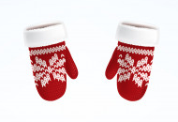
Faodaidh. Cuir ort do sgarfa agus do mhiotagan.
Notes:
Yes (you may). Put on your scarf and your gloves.

